Slide 1
2019 beach assessment update:
Town of Southern Shores, NC
Ken Willson
Program Manager
Wilmington, North Carolina

Slide 2
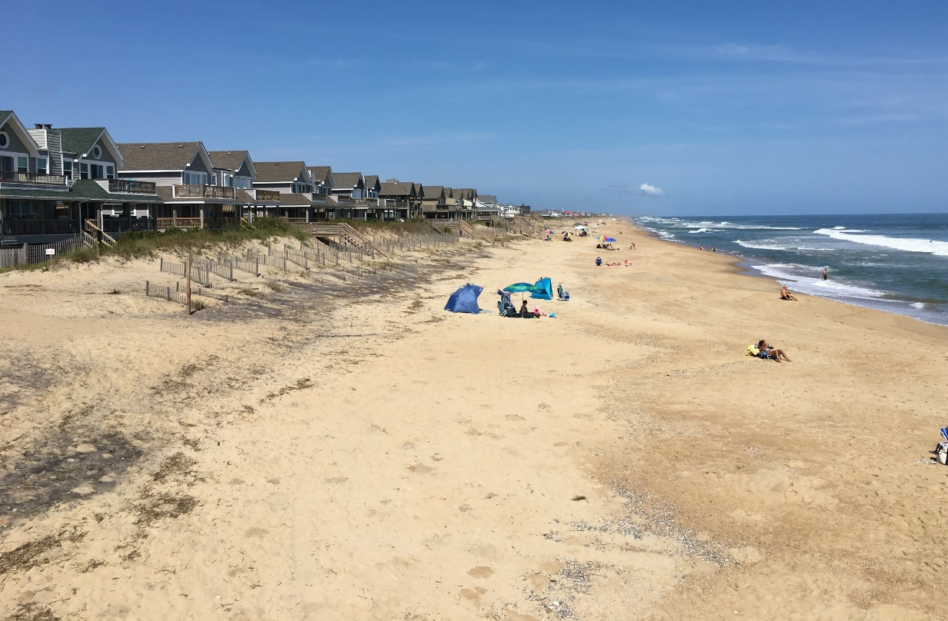
Presentation Outline:
Background
Volume Changes (Updates)
Volume and Cost Updates
Schedule
Recommendations

Slide 3
Background:
Stated Goals of Beach Management Plan:
provides a reasonable level of storm damage reduction to public and private development
mitigates long-term erosion that could threaten public and private development, recreational opportunities, and biological resources
maintains a healthy beach that supports valuable shorebird and sea turtle nesting habitat
Beach Management Plan recommendations was based on December 2017 survey data
Updated beach profile surveys – May 2019
Beach Management Plan aims to coordinate the efforts of Southern Shores with neighboring communities in Dare County to achieve cost savings where possible

Slide 4
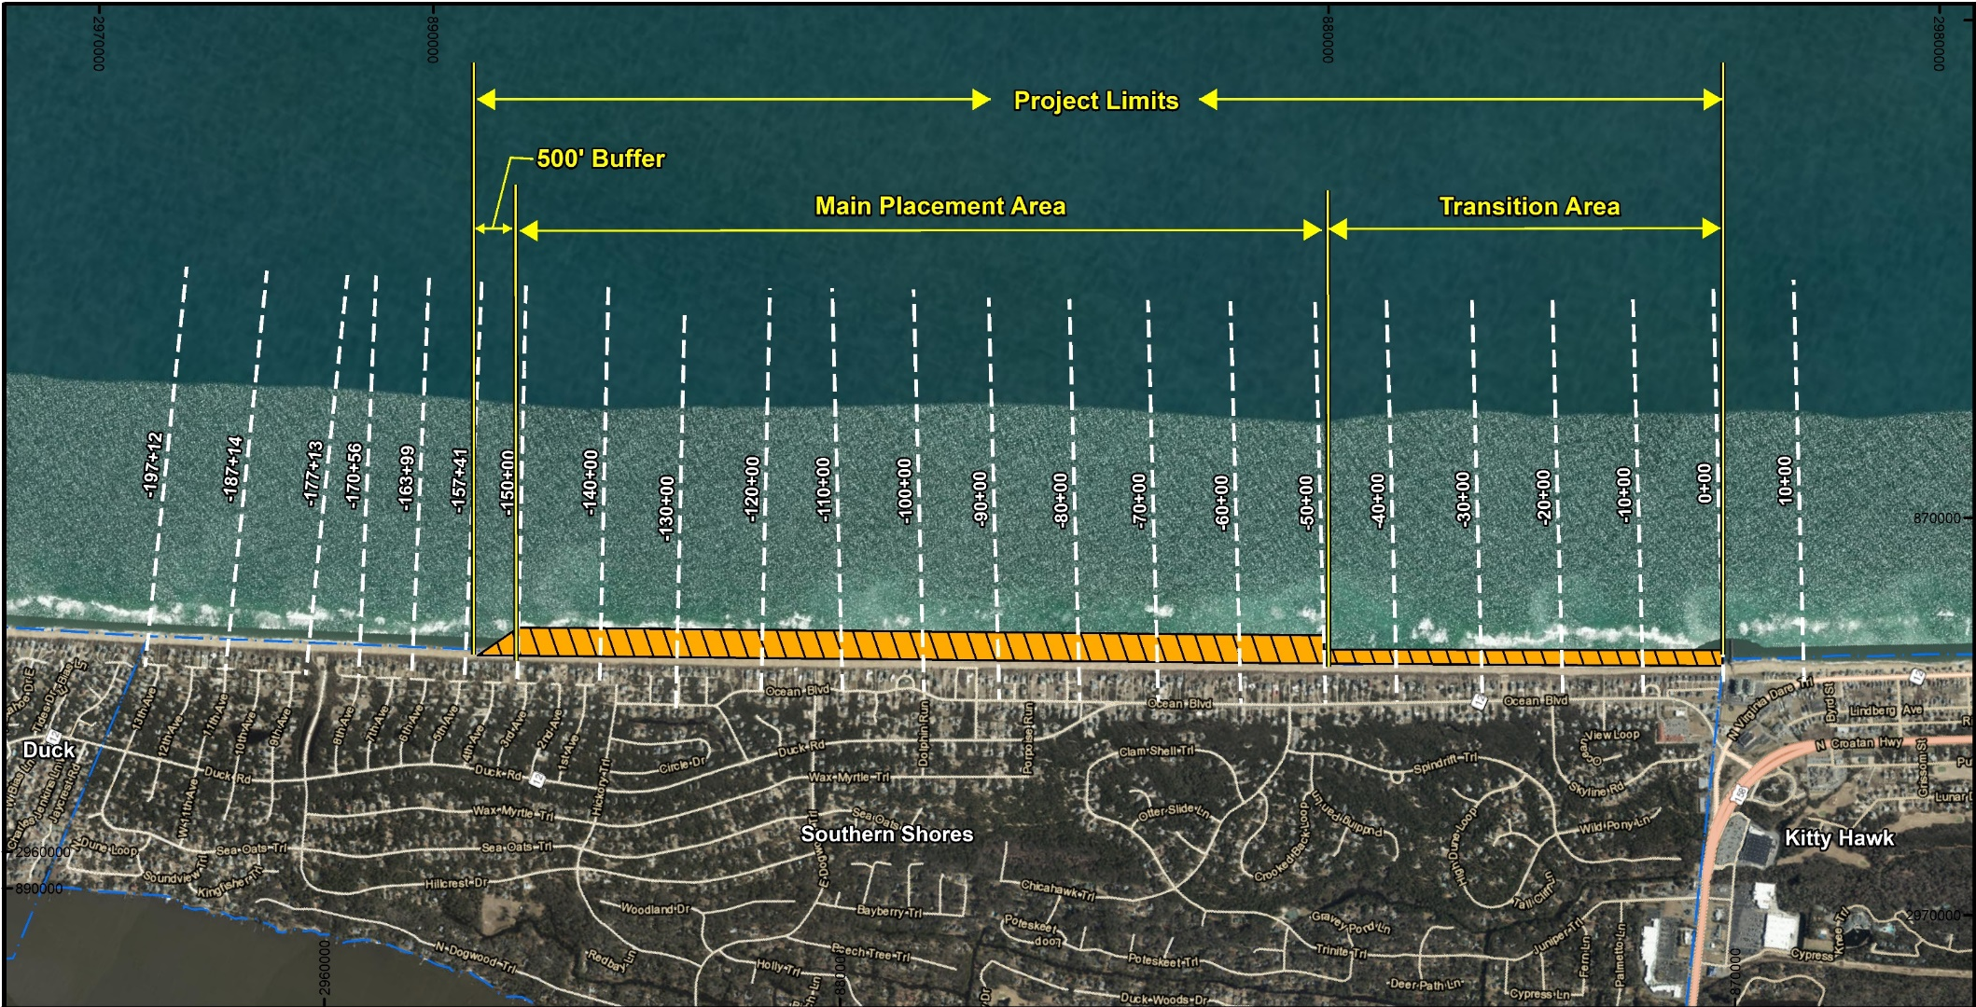
Background:
Northern
Portion

Slide 5
Volume Change (Update):
Three (3) Sections Referenced:
Northern Portion – North Town Boundary to 3rd Ave.
Main Fill Area – 3rd Ave. to Approx. 400 ft. South of Chicahawk Trl.
Transition Area - 400 ft. South of Chicahawk Trl. to South Town Boundary
Town Wide – Volume Changes between Dec. 2017 and May 2019
From 3rd Ave. South – Volume Changes between Oct. 2006 and May 2019
From 9th Ave. North – Volume Changes between Sept. 2013 and May 2019

Slide 6
Volume Change (Update):
Northern Portion:
Gained sand between Dec. 2017 and May 2019 (5.5 cy/lf./yr.)
Between Sept. 2013 and May 2019 (5.7 years), northern 2,000 feet of Town (Area north of 9th Ave.) had a volume change rate of +1.3 cy/lf./yr.
Main Fill Area – Gained sand between Dec. 2017 and May 2019 (4.6 cy/lf./yr.)
Transition Area – Lost sand between Dec. 2017 and May 2019 – average of -18.9 cy/lf./yr.)
Area south of 3rd Ave had a long-term average volume change rate of +2.5 cy/lf./yr.
Area south of 3rd Ave had a short-term average volume change rate of -3.0 cy/lf./yr.

Slide 7
Recommended Beach Fill Options:
Project Extent – Where to Place Sand
Project Volume – How Much Sand To Place
Historical Volume changes
Vulnerability Analysis
Volume Present in the “Volume Envelope”
Notes:
Consider Adding a Photo.

Slide 8
Beach Management Plan: Project Extent (Beach Volumes)

Slide 9
Project extent / project volume:
(Initial Recommendations)
Option 1: Based on Average Volume Envelope Target of 846 cy/lf. Required 45 cy/ft. Main Fill, 30 cy/ft. Transition Fill – 665,650 cy
Option 2: 30 cy/ft. Main Fill & Transition Fill – 492,300 cy
Option 3: 57 cy/ft. Main Fill, 30 cy/ft. Transition Fill – 803,050 cy

Slide 10
Project extent / project volume:

Slide 11
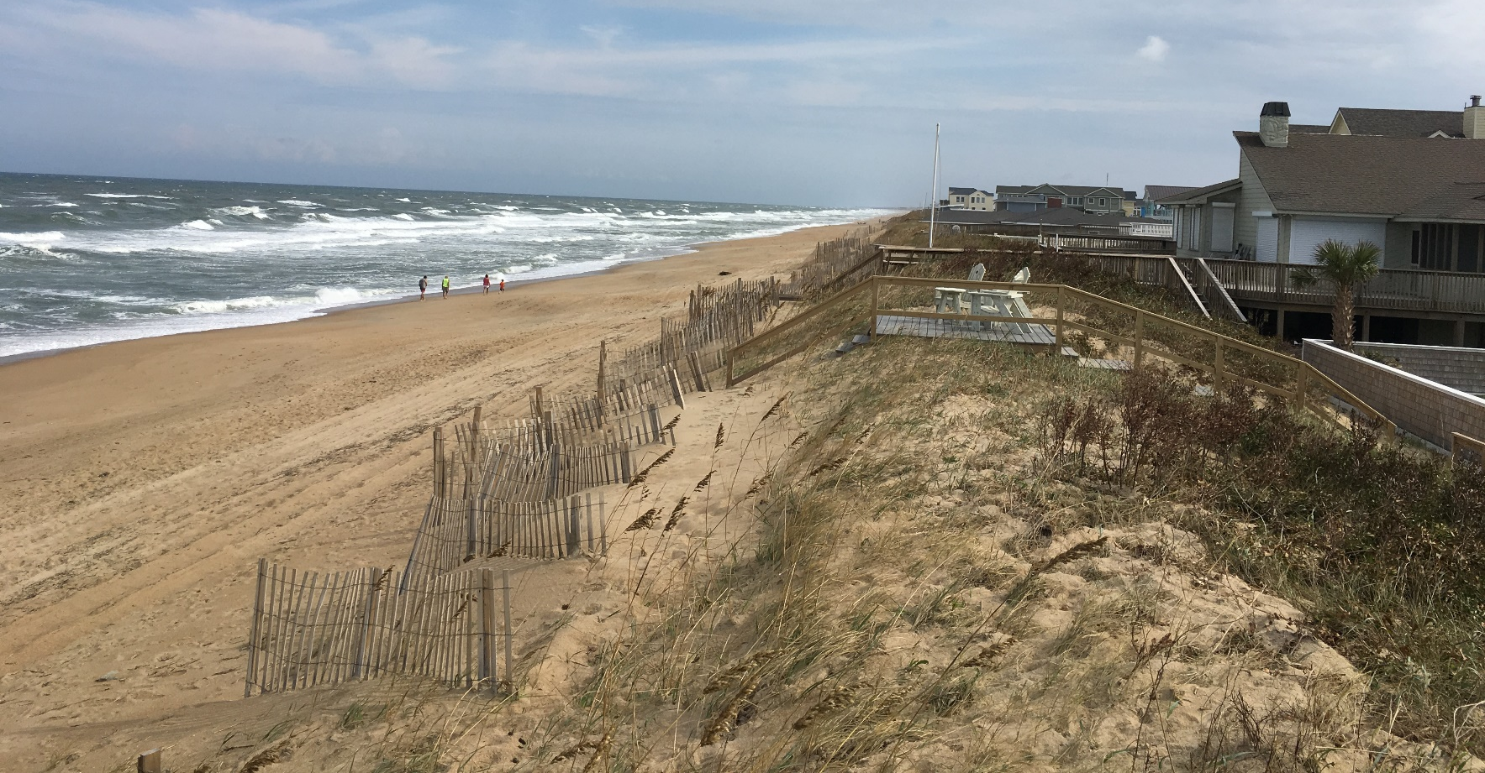
Updated project volume:
Option 1: Design to 846 cy/lf. and 3 cy/lf erosions rate = 828,400 cy
Option 3: Design to 858 cy/lf. and 3 cy/lf erosion rate = 1,025,800 cy

Slide 12
Storm Damage Reduction Project
Pre-Project Conditions

Slide 13
Storm Damage Reduction Project
Design
Beach
Design Beach

Slide 14
Storm Damage Reduction Project
Constructed Beach Fill
Initial Construction

Slide 15
Storm Damage Reduction Project
Post-Construction
Adjustment in 6-18 months
Equilibration of Beach Fill

Slide 16
Storm Damage Reduction Project
Advance Fill
Design
Beach
Nourishment Interval

Slide 17
Storm Damage Reduction Project
Design
Beach
Loss of Advance Fill
During Project Interval
Nourishment Interval

Slide 18
cost:
Page 22 of the Report

Slide 19
Schedule:

Slide 20
Recommendations:
Determine Whether to Pursue Project / Which Option To Pursue
Continue Coordination with County and Neighboring Communities
Initiate Financial Planning
Initiate Permitting and Design of the Beach Fill*
Continued Monitoring of the Beach Profiles (2020)
* Assumes the Town Decides to Pursue a Project

Slide 21
QUESTIONS
Ken Willson
Kenneth.Willson@aptim.com
910 443 4471

Slide 22
Profile Station 170+56: (8th Ave.)

Slide 23
Profile Station 170+56: (8th Ave.)

Slide 24
Area north: (7th Ave)
Photos Taken Sept. 11, 2019: Dry Sand Beach

Slide 25
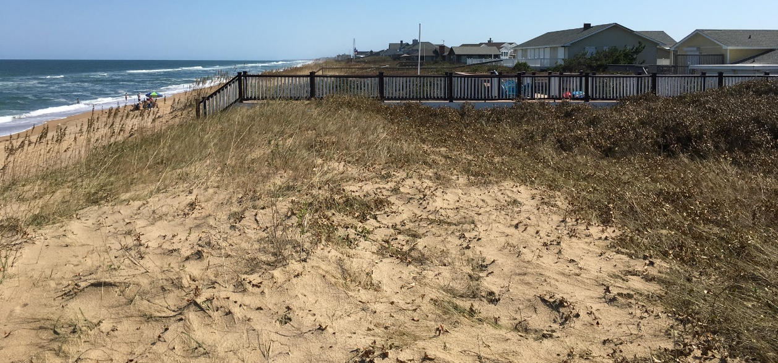
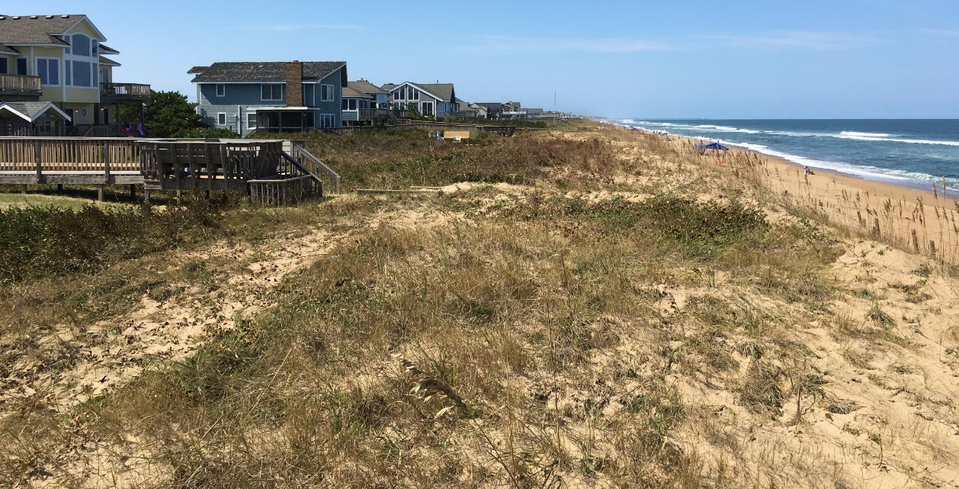
Area north: (7th ave)
Photos Taken Sept. 11, 2019: Dune System

Slide 26
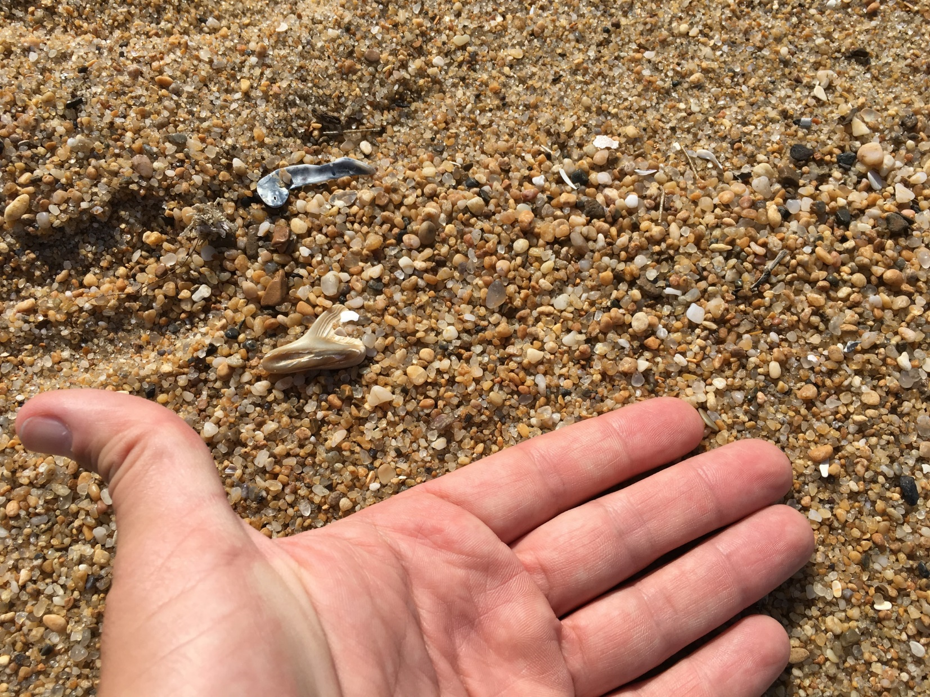
Area north: (7th ave)

Slide 27
Beach Management Plan: Project Extent (Beach Volumes)

Slide 28
Beach Management Plan: Project Extent (Beach Volumes)

